Slide 1


Curved (representational) Bregman divergences and their applications
Frank Nielsen
Sony Computer Science Laboratories, Inc.
Geometric Science of Information
31st October 2025

Slide 2


Bregman divergences (1960’s)
F: Θ⊆ℝ^{m}→ℝ a strictly convex and smooth
real-valued function on a finite dim. Hilbert space <.,.>
Bregman divergence B_{F}: Θ x RelativeInterior(Θ) →ℝ_{≥0}
Lev M. Bregman
(1941 - 2023)
Photo: courtesy of
Alexander Fradkov
B_{F}(θ₁ : θ₂)=F(θ₁)-F(θ₂)-< θ₁ - θ_{2 ,} ∇F(θ₂) >
Smooth measure of discrepancy, not a metric distance because it violates the triangle inequality.
BD is asymmetric when F is not quadratic function. Hence the delimiter notation “:” instead of B_{F}(θ₁ , θ₂)
BD interpreted as remainder of a first order Taylor expression of F(θ₁) around θ₂:
F(θ₁)=F(θ₂)+< θ₁ - θ_{2 ,} ∇F(θ₂) >+ B_{F}(θ₁ : θ₂)
Taylor remainder
Example of remainder: Lagrange remainder (smooth C² generators): ∇²F SPD ⇒ B_{F}(θ₁ : θ₂) ≥ 0
B_{F}(θ₁ : θ₂)= ½ (θ₂- θ₁)^{T} ∇²F(θ) (θ₂- θ₁) ≥0 , θ ∈ [θ₁ θ₂]
Notes:
https://en.wikipedia.org/wiki/Mathematical_operators_and_
ℝ
symbols_in_Unicode
Θθ∇≻ξ∈
http://lib.physcon.ru/doc?id=5d34ad008433
Σ
Lev Meerovich Bregman
(1941 - 2023)

Slide 3
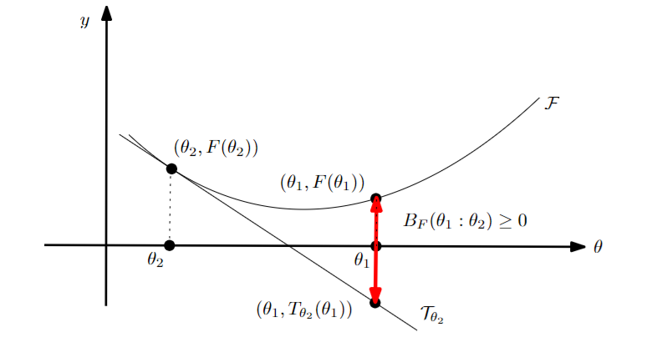
Geometric interpretation of BD as a vertical gap on the graph (θ,F(θ)):
B_{F}(θ₁ : θ₂)=F(θ₁) - (F(θ₂)+< θ₁ - θ_{2 ,} ∇F(θ₂) >)
= T_{θ2}(θ₁) : Tangent of the function graph at θ₂ evaluated at θ₁
The chord gap divergence and a generalization of the Bhattacharyya distance, IEEE ICASSP 2018

Slide 4



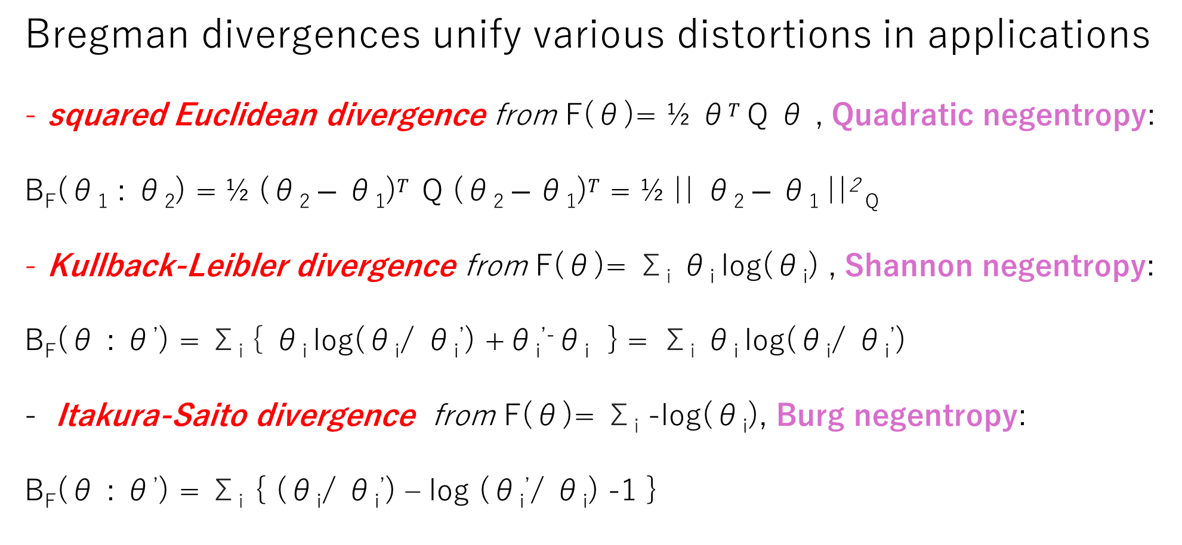
Bregman divergences: Versatile class of dissimilarities
Bregman divergences unify various distortions in applications
squared Euclidean divergence from F(θ)= ½ θ$T$ Q θ , Quadratic negentropy:
B_{F}(θ₁ : θ₂) = ½ (θ₂ $− \text{θ}\text{1}\text{)}T$ Q (θ₂ $− \text{θ}\text{1}\text{)}T$ = ½ || θ₂ $− \text{θ}\text{1} \text{||}$² _{Q}
Kullback-Leibler divergence from F(θ)= Σ_{i} θ_{i} log(θ_{i}) , Shannon negentropy:
B_{F}(θ : θ’) = Σ_{i} { θ_{i} log(θ_{i}/ θ_{i}’) +θ_{i}^{’-}θ_{i} } = Σ_{i} θ_{i} log(θ_{i}/ θ_{i}’)
Itakura-Saito divergence from F(θ)= Σ_{i} -log(θ_{i}), Burg negentropy:
B_{F}(θ : θ’) = Σ_{i} { (θ_{i}/ θ_{i}’) – log (θ_{i}’/ θ_{i}) -1 }
Notes:
Q SPD,

Slide 5
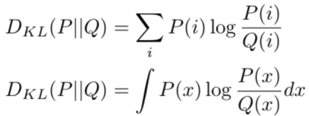

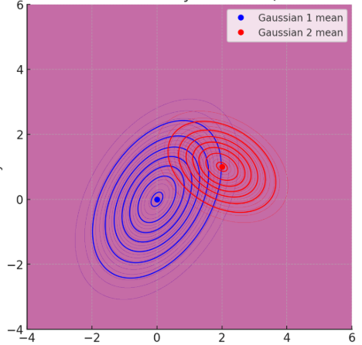
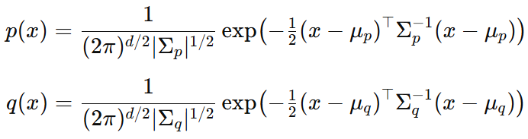
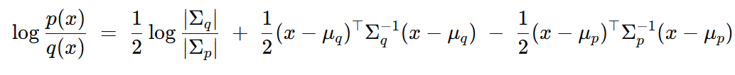
Relative entropy between Gaussian distributions?
Relative entropy = cross-entropy minus entropy, a dissimilarity measure in information theory, statistics, ML, etc.
called Kullback-Leibler divergence (KLD) in information theory:
How to calculate the KLD between multivariate Gaussian distributions?
D_{KL}[p(x):q(x)]= ∫ p(x) log (p(x)/q(x)) dμ(x)
KLD integrals ∫ is non-trivial but….
We need expectation wrt p(x) of this term !?
Notes:
a f-divergence for f(u)=-log u

Slide 6

Bregman divergences in ML: Exponential families
Kullback-Leibler divergence between two probability densities:
D_{KL}[p(x):q(x)]= ∫ p(x) log (p(x)/q(x)) dμ(x)
can be difficult to calculate in closed form because of the integral ∫
But Kullback-Leibler divergence between two probability densities of an exponential family with densities p(x| θ) = exp( <t(x), θ >-F(θ) )
amount to a reverse Bregman divergence B_{F}^{rev}(θ₁ : θ₂) := B_{F}(θ₂ : θ₁)
where F is the cumulant function (log partition/log Laplace function)
D_{KL}[p(x|θ₁) : p(x|θ₂) ] = B_{F}^{rev}(θ₁ : θ₂) = B_{F}(θ₂ : θ₁)
BDs wrt CFs between parameters = reverse KLD distributions
⇒ Easy calculations of KLDs
Bypass the ∫, ∇F in BD easy to calculate!
Azoury, Katy S., and Manfred K. Warmuth. "Relative loss bounds for on-line density estimation with the exponential family of distributions." Machine learning 43 (2001)
Notes:
∫μ
∇F easy!
Information geometry proves that B_{F}(θ₁ : θ₂)= D_{KL}*[p(x|θ₁) : p(x|θ₂) ]
when F(θ)=log ∫ exp(<x, θ >) dμ(x) where D_{KL}*[p(x):q(x)]:= D_{KL}[q(x):p(x)] is the reverse Kullback-Leibler divergence

Slide 7
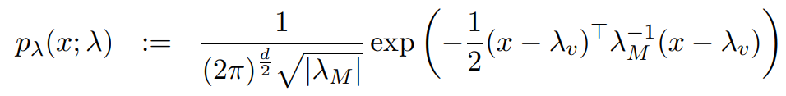
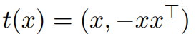
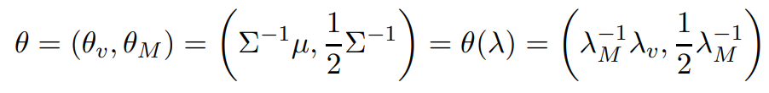
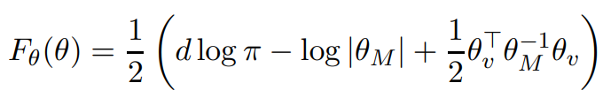
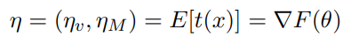
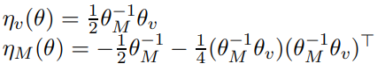
Example: KLD between Gaussians from BD
D_{KL}[p(x|θ₁) : p(x|θ₂) ] = B_{F}(θ₂ : θ₁)
p(x| θ) = exp( <t(x), θ >-F(θ) )

Slide 8
Bregman divergences in machine learning…
Kullback-Leibler divergence between two probability densities:
D_{KL}[p(x):q(x)]= ∫ p(x) log (p(x)/q(x)) dμ(x)
is difficult to calculate in closed form because of the integral ∫ …
But Kullback-Leibler divergence between two probability densities of a natural exponential family
amount to a reverse Bregman divergence B_{F}^{rev}(θ₁ : θ₂):= B_{F}(θ₂ : θ₁)
D_{KL}[p(x|θ₁) : p(x|θ₂) ] = B_{F}^{rev}(θ₁ : θ₂) = B_{F}(θ₂ : θ₁)
⇒ Easy calculations of KLDs
with densities p(x| θ) ∝ exp(<x, θ >)
Bypass the ∫, ∇F in BD easy to calculate!
Azoury, Katy S., and Manfred K. Warmuth. "Relative loss bounds for on-line density estimation with the exponential family of distributions." Machine learning 43 (2001)
Notes:
∫μ
∇F easy!
Information geometry proves that B_{F}(θ₁ : θ₂)= D_{KL}*[p(x|θ₁) : p(x|θ₂) ]
when F(θ)=log ∫ exp(<x, θ >) dμ(x) where D_{KL}*[p(x):q(x)]:= D_{KL}[q(x):p(x)] is the reverse Kullback-Leibler divergence

Slide 9
Representational Bregman divergences (2009)
In fact, we used a representation function R (eg, θ(λ )) for
Calculating the KLD between two multivariate normal distributions:
B_{F,R}(λ ₁ : λ ₂):= B_{F}(R(λ ₁ ):R(λ ₂))
= F(R(λ ₁))-F(R(λ ₂))-< R(λ ₁)–R(λ ₂ ),∇F(R(λ ₂) ) >
Note that F∘R may not be a Bregman generator, i.e., not be strictly convex.
KLD between two densities of a generic exponential family with natural parameter from representation function
θ(λ ): natural parameter corresponding to λ, representation function R(.)=θ(. )
include normal, Gamma/Beta, Wishart, Poisson, etc.
D_{KL}[p(x| λ ₁) : p(x| λ ₂) ] = B_{F,} _{θ} ^{rev}(θ (λ ₁): θ (λ ₂))=B_{F,} _{θ}(θ (λ ₂): θ (λ ₁))
Notes:
Λ
A *representational Bregman divergence* is a Bregman divergence applied on a representation of the parameter space.
The α-divergences extended positive measures are an example of representational Bregman divergences.
Dual representational Fenchel-Young divergence with dual representation function
But restricted to the (m-1)-dimensional probability simplex is not a
Nielsen, Frank, and Richard Nock.
"The dual Voronoi diagrams with respect to representational Bregman divergences." IEEE ISVD 2009

Slide 10
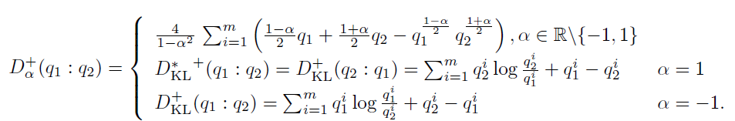
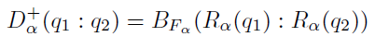
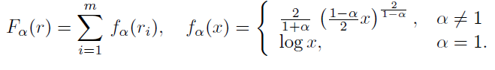
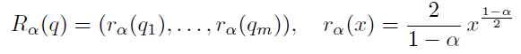
Extendedα-divergences are representational BDs
α-divergences extended to m-dim. positive measures (orthant cone)
are representational Bregman divergences:
Bregman generator:
Representation function:
Bregman divergence:
B_{F}(θ₁ : θ₂)=F(θ₁)-F(θ₂)-< θ₁ - θ_{2 ,} ∇F(θ₂) >
"The dual Voronoi diagrams with respect to representational Bregman divergences." IEEE ISVD 2009

Slide 11
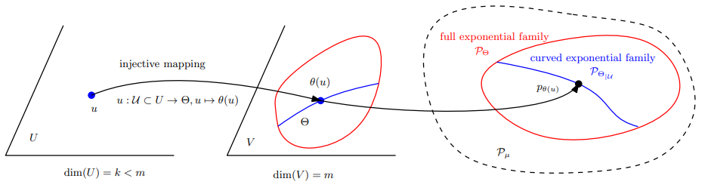
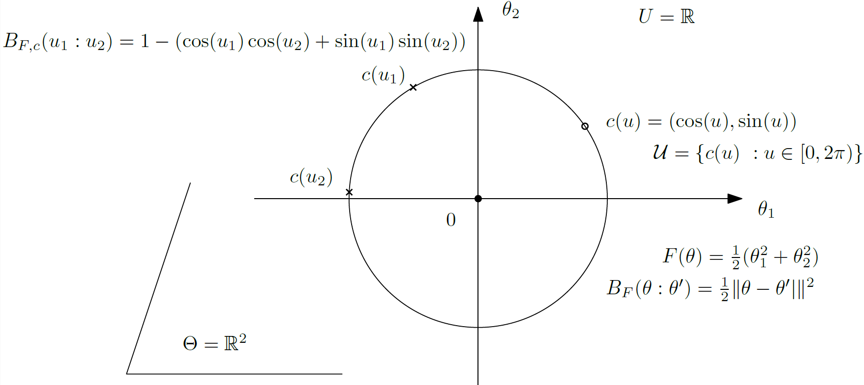
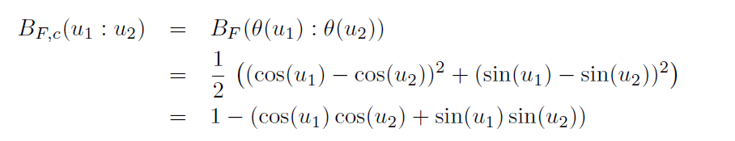
Curved Bregman divergences (cBDs)
Consider a domain U which maps to a subset of Θ by θ =c(u) with dim(U) < dim(Θ) : B_{F,c}(u₁ : u₂) := B_{F}(c(u₁ ):c( u₂)) is not Bregman when {c(u) | u ∈ U} not convex. cBDs usually not BDs unless constraints c(.) are affine
A toy example:
Curved circle Euclidean divergence
Notes:
Example:
KLD between 0-centered normal distributions with covariance matrices c(λ)=λΣ

Slide 12
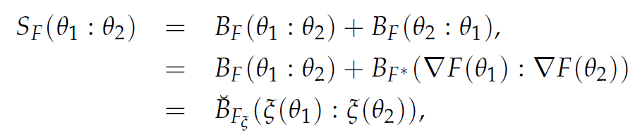
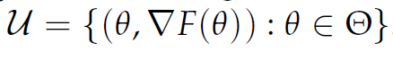
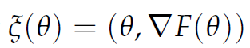
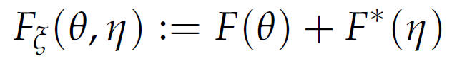
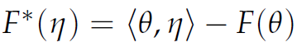
Example: Symmetrized Bregman divergences
= Jeffreys-Bregman divergences are curved Bregman divergences:
S_{F}(θ₁ ,θ₂)=< θ₁ -θ₂ ,η₁ -η ₂ >
Curved domain:
m-dimensional submanifold in 2m-dimensional space
(usually not cvx affine space, hence not a Bregman divergence)
“Sided and symmetrized Bregman centroids.” IEEE transactions on Information Theory 55.6 (2009)

Slide 13
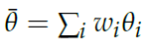
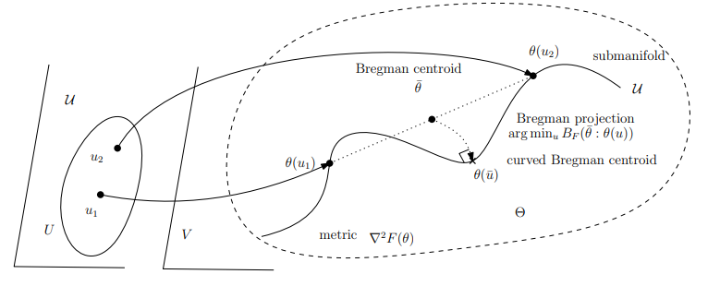
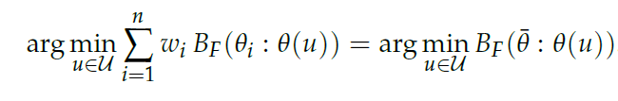
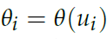
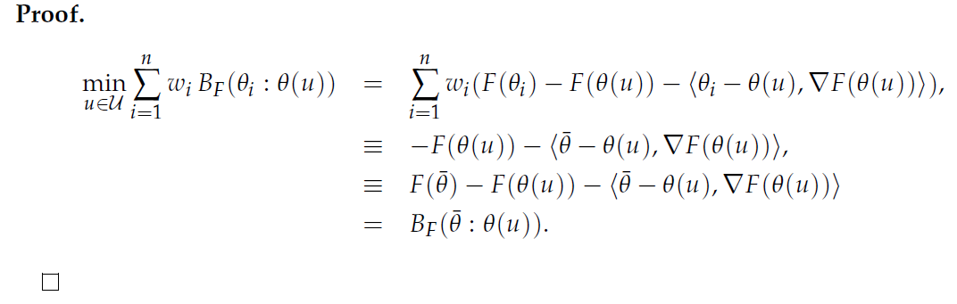
Curved Bregman centroid is the Bregman projection of the full Bregman centroid
Bregman projection
Theorem:
)
N-point opt.
One-point opt!
"What is... an information projection?" Notices of the AMS 65.3 (2018): 321-324.

Slide 14
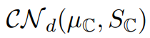
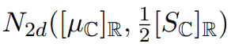
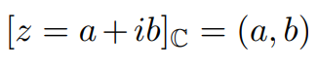
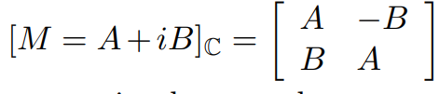
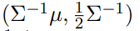
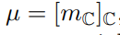
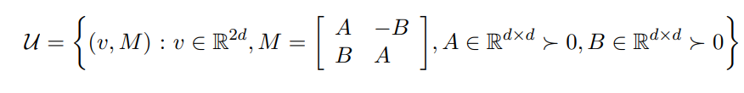
Another example of curved Bregman divergences:
Consider d-variate circular complex normal distributions
CNDs handled as 2d real normal distributions
Then KLD between CNDs amounts to a curved Bregman divergence:
Curved submanifold parameter in R^{2d} x Mat(2d)
Natural parameters
2504.05654

Slide 15
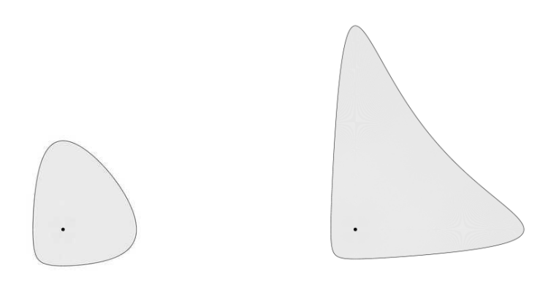
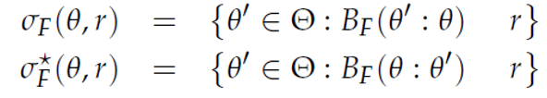
Space of Bregman balls
Example:
Itakura-Saito right and left spheres
Right-sided Bregman ball:
≤
Left-sided Bregman ball:
≤
Application: Boolean algebra of unions & intersections of Bregman balls

Slide 16
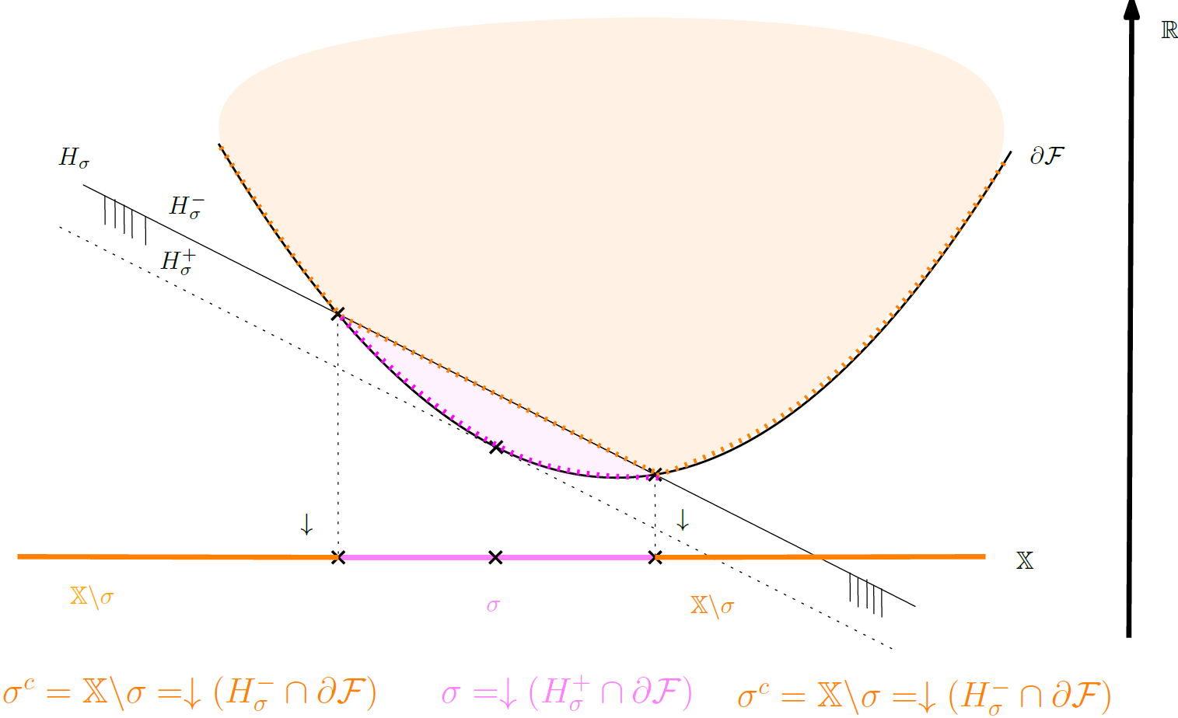
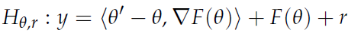
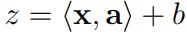
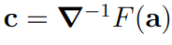
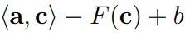
Lifting to potential Bregman generator graph & vertical projection
Right Bregman ball and its complement
↓ means vertical projection
S^{c}: complement of set S
To any sphere, associate a hyperplane:
Reciprocally, to a hyperplane cutting the
function graph, associate a sphere
Center:
Radius:

Slide 17
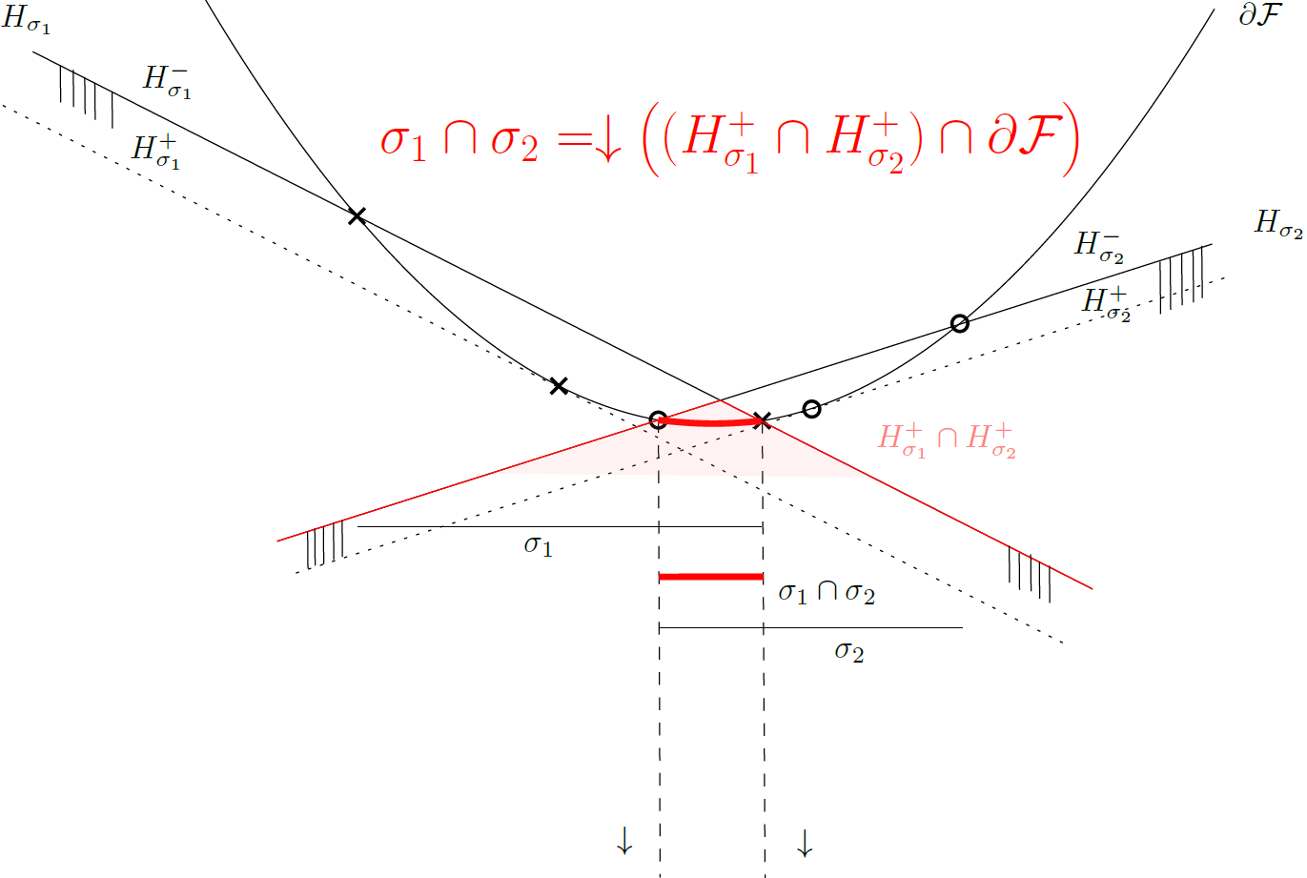
Intersection of two right Bregman balls
Boolean algebra:
intersection of spheres

Slide 18
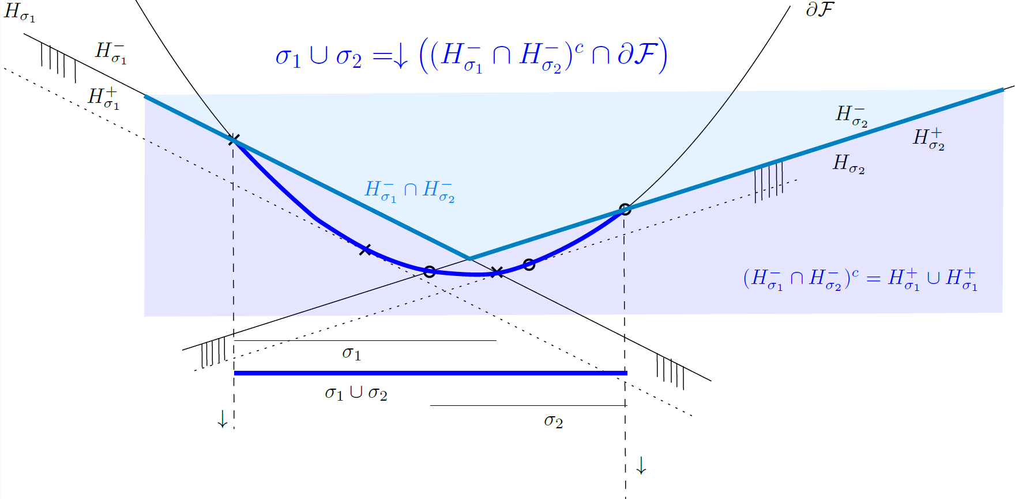
Union of two right Bregman balls
Boolean algebra:
Union of spheres
Set Morgan’s law: (A ∪ B)^{c} = A^{c} ∩ B^{c}
Complement of halfspace (H⁺)^{c}=H⁻
Notes:
De Morgan laws for sets

Slide 19
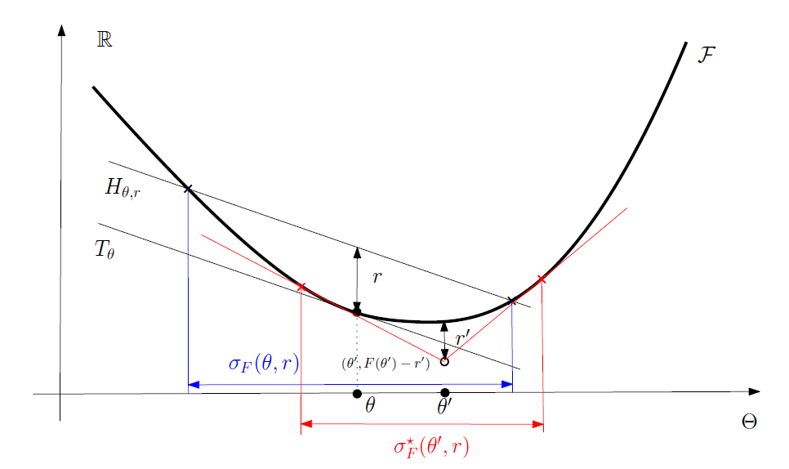
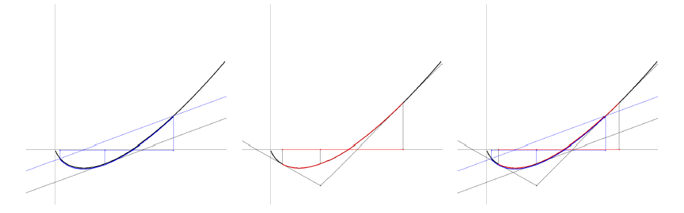
Dual Bregman balls
Example:
Shannon negentropy

Slide 20
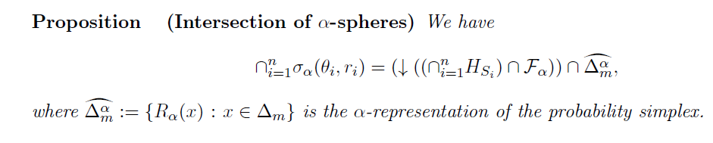
Thank you!
Consider space of representational BD balls (alpha-divergences)
Notes:
Vauban 1, 11h40

Slide 21



Slide 22
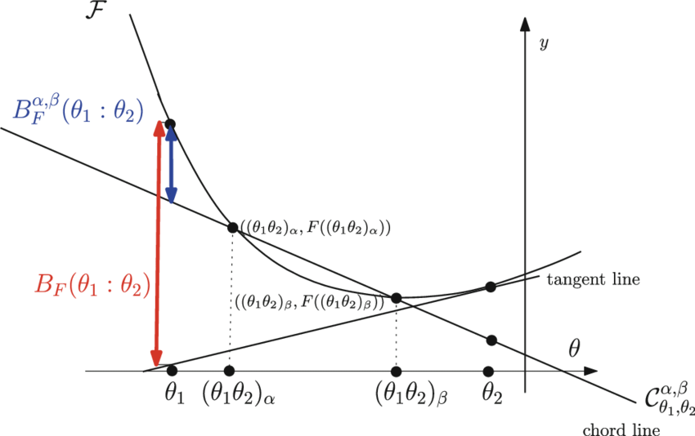
Geometric interpretation of BD as a vertical gap on the graph (θ,F(θ)):
B_{F}(θ₁ : θ₂)=F(θ₁) - (F(θ₂)+< θ₁ - θ_{2 ,} ∇F(θ₂) >)
= T_{θ2}(θ₁) : Tangent of the function graph at θ₂ evaluated at θ₁
Design novel divergences from graph of convex functions…
Example: Bregman chord divergence with application: zero-order optimization in ML
The chord gap divergence and a generalization of the Bhattacharyya distance, IEEE ICASSP 2018

Slide 23
Families of Bregman divergences: β-divergences
squared Euclidean divergence
（ext.) Kullback-Leibler divergence
Itakura-Saito divergence
Bregman generator F_{β}(θ)= θ^{β}/(β(β-1)) – θ/ (β-1) + 1/ β, β ∈ R - {0, 1}
β-divergence: B_{Fβ}(θ₁: θ₂)= (θ₁ ^{β}+ (β-1) θ₂ ^{β}- β θ₁ θ₂ ^{β-1)}/(β(β-1)) , R - {0, 1}
Allows one to unify various algorithms
Learn/tune scalar parameterβ depending on applications & datasets (ad hoc β)
β
β=2
β=1
β=0
Imre Csiszár, "Why least squares and maximum entropy? An axiomatic approach to inference for linear inverse problems." The annals of statistics 19.4 (1991): 2032-2066. [Theorem 4, page 2046]
Notes:
β-divergences, learn β
Thm 4 p 2046 of
Csiszar, Imre. "Why least squares and maximum entropy? An axiomatic approach to inference for linear inverse problems." The annals of statistics 19.4 (1991): 2032-2066.

Slide 24
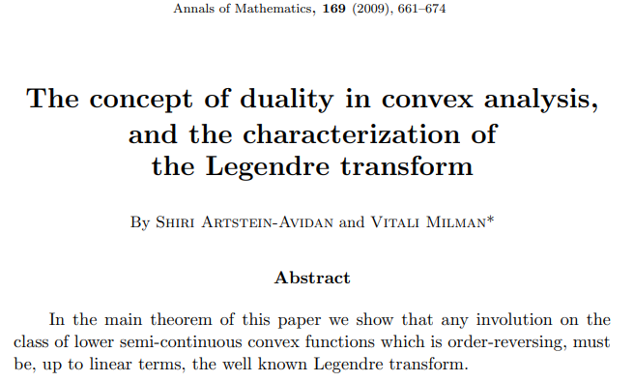

Generalized Legendre transforms (2009)

Slide 25



Generalized Artstein-Avidan—Milman Legendre transforms
where
is the Legendre-Fenchel transform
Shiri Artstein-Avidan and Vitali Milman. The concept of duality in convex analysis, and the
characterization of the Legendre transform. Annals of mathematics, 169:661–674, 2009.

Slide 26




Generalized Artstein-Avidan—Milman Legendre transforms
where
Affine-deformed convex functions of both argument and returned value remain convex:
arXiv:2507.20577

Slide 27


